Slide 1
CSE 521 - Operating Systems Fall 2026
Lecture - 11 Process Synchronization - I
Created by Dr. Tevfik Koşar
Presented By
Dr. Zulkar Nine

Slide 2

Roadmap
Process Synchronization
Race Conditions
Critical-Section Problem
Solutions to Critical Section
Different Implementations

Slide 3
Background
Concurrent access to shared data may result in data inconsistency
Maintaining data consistency requires mechanisms to ensure the orderly execution of cooperating processes
Consider consumer-producer problem:
Initially, count is set to 0
It is incremented by the producer after it produces a new buffer
and is decremented by the consumer after it consumes a buffer.

Slide 4
Issues with Concurrent Execution

Slide 5
Producer:
Shared Variables: count=0, buffer[]
while (true){ /* produce an item and put in nextProduced
while (count == BUFFER_SIZE)
; // do nothing
buffer [in] = nextProduced;
in = (in + 1) % BUFFER_SIZE;
count++;
}
Consumer:
while (1) {
while (count == 0)
; // do nothing
nextConsumed = buffer[out];
out = (out + 1) % BUFFER_SIZE;
count--;
} /* consume the item in nextConsumed

Slide 6
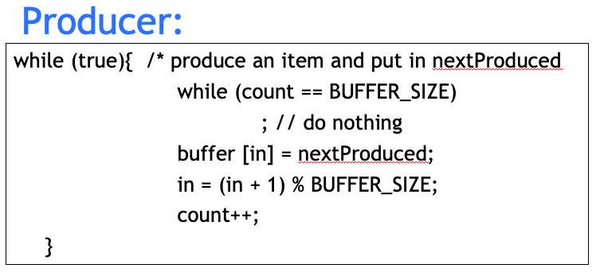

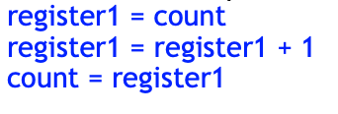
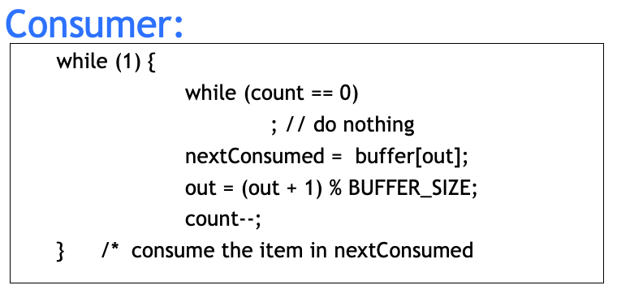
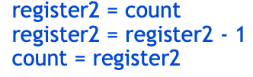
Shared Variables: count=0, buffer[]
10
11
12
Register
2
1 - 1
1
0+1
Count
1
1 + 1
0
0
1
2
2
2
2+1
3

Slide 7
Race Condition
count++ could be implemented as register1 = count register1 = register1 + 1 count = register1
count-- could be implemented as register2 = count register2 = register2 - 1 count = register2

Slide 8
Race Condition
count++ could be implemented as register1 = count register1 = register1 + 1 count = register1
count-- could be implemented as register2 = count register2 = register2 - 1 count = register2
Consider this execution interleaving with “count = 5” initially:
S0: producer execute register1 = count {register1 = 5} S1: producer execute register1 = register1 + 1 {register1 = 6} S2: consumer execute register2 = count {register2 = 5} S3: consumer execute register2 = register2 - 1 {register2 = 4} S4: producer execute count = register1 {count = 6 } S5: consumer execute count = register2 {count = 4}

Slide 9
Race Condition
Race condition: The situation where several processes access and manipulate shared data concurrently. The final value of the shared data depends upon which process finishes last.
To prevent race conditions, concurrent processes must be synchronized.
Ensure that only one process at a time is manipulating the variable counter.
The statements
count++;
count--;
must be performed atomically.
Atomic operation means an operation without interruption.

Slide 10
Race Condition
Significant race conditions in I/O & variable sharing
char chin, chout;//shared
void echo()
{
do {
chin = getchar();
chout = chin;
putchar(chout);
}
while (...);
}
A
> ./echo
Hello world!
Hello world!
Single-threaded echo

Slide 11
Race Condition
Significant race conditions in I/O & variable sharing
char chin, chout;//shared
void echo()
{
do {
chin = getchar();
chout = chin;
putchar(chout);
}
while (...);
}
char chin, chout; //shared
void echo()
{
do {
chin = getchar();
chout = chin;
putchar(chout);
}
while (...);
}
A
B
1
4
2
5
3
6
lucky
CPU
scheduling
☺
> ./echo
Hello world!
Hello world!
> ./echo
Hello world!
Hello world!
Single-threaded echo
Multithreaded echo (lucky)

Slide 12
Race Condition
Significant race conditions in I/O & variable sharing
char chin, chout;//shared
void echo()
{
do {
chin = getchar();
chout = chin;
putchar(chout);
}
while (...);
}
char chin, chout; //shared
void echo()
{
do {
chin = getchar();
chout = chin;
putchar(chout);
}
while (...);
}
A
B
1
2
5
3
6
4
unlucky
CPU
scheduling
☹
> ./echo
Hello world!
Hello world!
Single-threaded echo

Slide 13
Race Condition
Significant race conditions in I/O & variable sharing
void echo()
{
char chin, chout;
do {
chin = getchar();
chout = chin;
putchar(chout);
}
while (...);
}
void echo()
{
char chin, chout;
do {
chin = getchar();
chout = chin;
putchar(chout);
}
while (...);
}
A
B
1
2
5
3
6
4
unlucky
CPU
scheduling
☹
> ./echo
Hello world!
Hello world!
Single-threaded echo

Slide 14
Race Condition
Significant race conditions in I/O & variable sharing
in this case, replacing the global variables with local variables did not solve the problem
we actually had two race conditions here:
one race condition in the shared variables and the order of value assignment
another race condition in the shared output stream: which thread is going to write to output first (this race persisted even after making the variables local to each thread)
==> generally, problematic race conditions may occur whenever resources and/or data are shared (by processes unaware of each other or processes indirectly aware of each other)

Slide 15
Critical Section/Region
Critical section/region: segment of code in which the process may be changing shared data (eg. common variables)
No two processes should be executing in their critical sections at the same time --> prevents race conditions
Critical section problem: design a protocol that the processes use to cooperate

Slide 16


Critical Section
The “indivisible” execution blocks are critical regions
a critical region is a section of code that should be executed by only one process or thread at a time
A
common critical region
B
although it is not necessarily the same region of memory or section of program in both processes
A
A’s critical region
B
B’s critical region
==> but physically different or not, what matters is that these regions cannot be interleaved or executed in parallel (pseudo or real)

Slide 17
Solution to Critical-Section Problem
A solution to the critical-section problem must satisfy the following requirements:
1. Mutual Exclusion –
2. Progress -

Slide 18
Solution to Critical-Section Problem
A solution to the critical-section problem must satisfy the following requirements:
1. Mutual Exclusion - If process P_{i} is executing in its critical section, then no other processes can be executing in their critical sections
2. Progress - If no process is executing in its critical section and there exist some processes that wish to enter their critical section, then the selection of the processes that will enter the critical section next cannot be postponed indefinitely

Slide 19
Solution to Critical-Section Problem
3. Bounded Waiting - A bound must exist on the number of times that other processes are allowed to enter their critical sections after a process has made a request to enter its critical section and before that request is granted
Assume that each process executes at a nonzero speed
No assumption concerning relative speed of the N processes

Slide 20
Mutual Exclusion
Critical Sections
char chin, chout;//shared
void echo()
{
do {
chin = getchar();
chout = chin;
putchar(chout);
}
while (...);
}
char chin, chout; //shared
void echo()
{
do {
chin = getchar();
chout = chin;
putchar(chout);
}
while (...);
}
A
B
> ./echo
Hello world!
Hello world!
> ./echo
Hello world!
Hello world!
Single-threaded echo
Multithreaded echo (lucky)

Slide 21

Mutual Exclusion
We need mutual exclusion from critical regions
critical regions can be protected from concurrent access by padding them with entrance and exit gates (we’ll see how later): a thread must try to check in, then it must check out
void echo()
{
char chin, chout;
do {
chin = getchar();
chout = chin;
putchar(chout);
}
while (...);
}
void echo()
{
char chin, chout;
do {
chin = getchar();
chout = chin;
putchar(chout);
}
while (...);
}
A
B
enter critical region?
exit critical region
enter critical region?
exit critical region

Slide 22

Mutual Exclusion
Desired effect: mutual exclusion from the critical region
thread A reaches the gate to the critical region (CR) before B
A
B
critical region
A
B
critical region
HOW is this
achieved??

Slide 23
Mutual Exclusion
Desired effect: mutual exclusion from the critical region
thread A reaches the gate to the critical region (CR) before B
A
B
critical region

Slide 24

Mutual Exclusion
Desired effect: mutual exclusion from the critical region
thread A reaches the gate to the critical region (CR) before B
thread A enters CR first, preventing B from entering (B is waiting or is blocked)
thread A exits CR; thread B can now enter
thread B enters CR
A
B
critical region
A
B
HOW is this
achieved??
A
B
A
B

Slide 25
Mutual Exclusion
Implementation 1 — disabling hardware interrupts 
it works, but not reasonable!
What are the issues?
void echo()
{
char chin, chout;
do {
chin = getchar();
chout = chin;
putchar(chout);
}
while (...);
}
disable hardware interrupts
enable hardware interrupts

Slide 26
Mutual Exclusion
Implementation 1 — disabling hardware interrupts 
it works, but not reasonable!
what guarantees that the user process is going to ever exit the critical region?
meanwhile, the CPU cannot interleave any other task, even unrelated to this race condition
the critical region becomes one physically indivisible block, not logically
also, this is not working in multi-processors
void echo()
{
char chin, chout;
do {
chin = getchar();
chout = chin;
putchar(chout);
}
while (...);
}
disable hardware interrupts
enable hardware interrupts

Slide 27
Mutual Exclusion
Implementation 2 — simple lock variable
A
B
critical region

Slide 28
Mutual Exclusion
Implementation 2 — simple lock variable
thread A reaches CR and finds a lock at 0, which means that A can enter
thread A sets the lock to 1 and enters CR, which prevents B from entering
thread A exits CR and resets lock to 0; thread B can now enter
thread B sets the lock to 1 and enters CR
A
B
critical region
A
B
A
B
A
B

Slide 29
Mutual Exclusion
Implementation 2 — simple lock variable
the “lock” is a shared variable
entering the critical region means testing and then setting the lock
exiting means resetting the lock
bool lock = FALSE;
void echo()
{
char chin, chout;
do {
chin = getchar();
chout = chin;
putchar(chout);
}
while (...);
}
test lock, then set lock
reset lock
while (lock);
/* do nothing: loop */
lock = TRUE;
lock = FALSE;

Slide 30
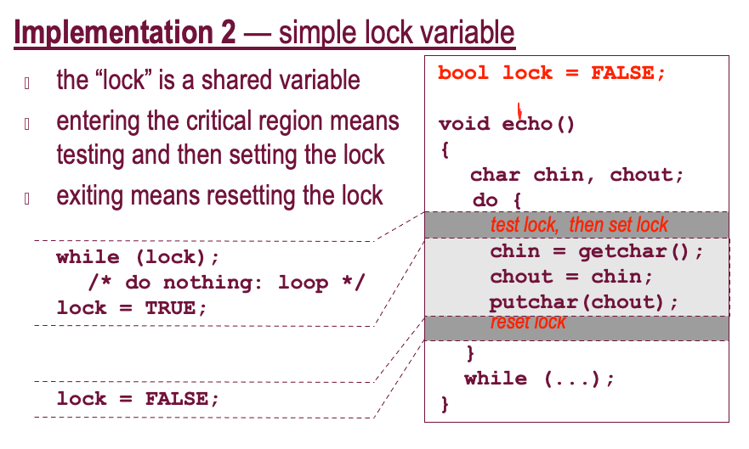
Mutual Exclusion
Implementation 2 — simple lock variable 
thread A reaches CR and finds a lock at 0, which means that A can enter
A
B
critical region

Slide 31
Mutual Exclusion
Implementation 2 — simple lock variable 
thread A reaches CR and finds a lock at 0, which means that A can enter
1.1 but before A can set the lock to 1, B reaches CR and finds the lock is 0, too
A
B
critical region
A
B

Slide 32
Mutual Exclusion
Implementation 2 — simple lock variable 
thread A reaches CR and finds a lock at 0, which means that A can enter
1.1 but before A can set the lock to 1, B reaches CR and finds the lock is 0, too
1.2 A sets the lock to 1 and enters CR but cannot prevent the fact that . . .
A
B
critical region
A
B
A
B

Slide 33

Mutual Exclusion
Implementation 2 — simple lock variable 
thread A reaches CR and finds a lock at 0, which means that A can enter
1.1 but before A can set the lock to 1, B reaches CR and finds the lock is 0, too
1.2 A sets the lock to 1 and enters CR but cannot prevent the fact that . . .
1.3 . . . B is going to set the lock to 1 and enter CR, too
A
B
critical region
A
B
A
B
A
B

Slide 34
Mutual Exclusion
Implementation 2 — simple lock variable 
bool lock = FALSE;
void echo()
{
char chin, chout;
do {
chin = getchar();
chout = chin;
putchar(chout);
}
while (...);
}
suffers from the very flaw we want to avoid: a race condition
the problem comes from the small gap between testing that the lock is off and setting the lock
while (lock); lock = TRUE;
it may happen that the other thread gets scheduled exactly in between these two actions (falls in the gap)
so they both find the lock off and then they both set it and enter
test lock, then set lock
reset lock

Slide 35




Mutual Exclusion
Implementation 3 — “indivisible” lock variable 
the indivisibility of the “test-lock-and-set-lock” operation can be implemented with the hardware instruction TSL
void echo()
{
char chin, chout;
do {
chin = getchar();
chout = chin;
putchar(chout);
}
while (...);
}
TSL
test-and-set-lock
set lock off
Tanenbaum, A. S. (2001)
Modern Operating Systems (2nd Edition).

Slide 36
Mutual Exclusion
Implementation 3 — “indivisible” lock variable 
thread A reaches CR and finds the lock at 0 and sets it in one shot, then enters
1.1’ even if B comes right behind A, it will find that the lock is already at 1
thread A exits CR, then resets lock to 0
thread B finds the lock at 0 and sets it to 1 in one shot, just before entering CR
A
B
critical region
A
B
A
B
A
B

